Slide 1

Alt-Lend Score
Powering E-Commerce and Alternative Lending
for
Future Millenials/Unbanked / Underbanked.

Slide 2











Lean Team : Hackathon
Sidd Gangavarupu
3 +years in Computer Hacking, Designer, Team player, Developer aspiring to go to MIT
Rajesh Koppula
11+ Years Risk Management, Financial Strategies, Marketing Analytics, Big Data

Slide 3
Demo - Mockup

Slide 4

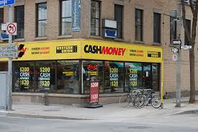
Opportunity : Customers
Future Millennial
ALT-LEND SCORE
?
?
Under-banked
ALT-LEND SCORE
?
?
ALT-LEND SCORE
Un-banked

Slide 5
Opportunity : Alternative Lenders
$23 Billion +
Alternative Lending is at the cusp of an exponential growth

Slide 6
Opportunity : E-Commerce
E-Commerce expected to grow 41% by 2018

Slide 7

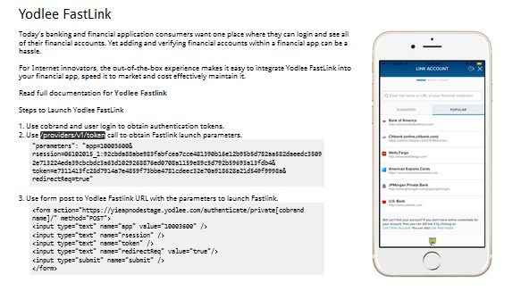
ALT-LEND SCORE : ARCHITECTURE
Customer
Inputs
Data Aggregation / Algorithms
ALT-LEND SCORE

Slide 8
How are we going to Monetize it ?
Alternative Lenders
Alt-Lend
Score (API)
Un-banked
Payment Network
Merchants
UNI-CORN
E-COMMERCE
Under-banked
Acquirers
Future Millennial

Slide 9
Questions ?

